Slide 1
Parallel and Distributed Computing
Lecture 2
Amdahl’s Law

Slide 2
Outline
Amdahl’s Law of Parallel Speedup
Karp-Flatt Metric
Types of Parallelism
  Data-parallelism
  Functional-parallelism
  Pipelining
Multi-processor vs Multi-computer
Cluster vs Network of workstations

Slide 3
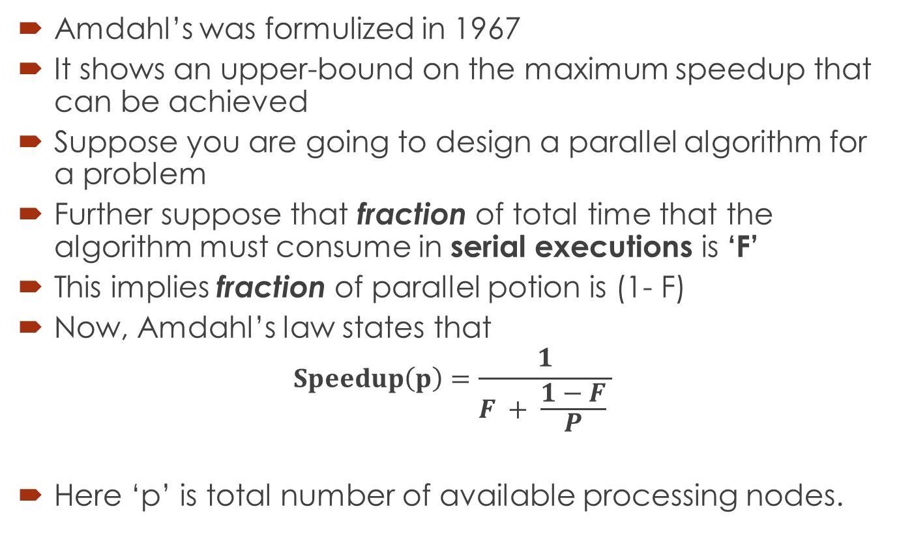
Amdahl’s Law
Amdahl’s was formulized in 1967
It shows an upper-bound on the maximum speedup that can be achieved
Suppose you are going to design a parallel algorithm for a problem
Further suppose that fraction of total time that the algorithm must consume in serial executions is ‘F’
This implies fraction of parallel potion is (1- F)
Now, Amdahl’s law states that
$$Speedup\left(p\right)=\frac{1}{F + \frac{1−F}{P} }$$
Here ‘p’ is total number of available processing nodes.
Notes:
What and when

Slide 4
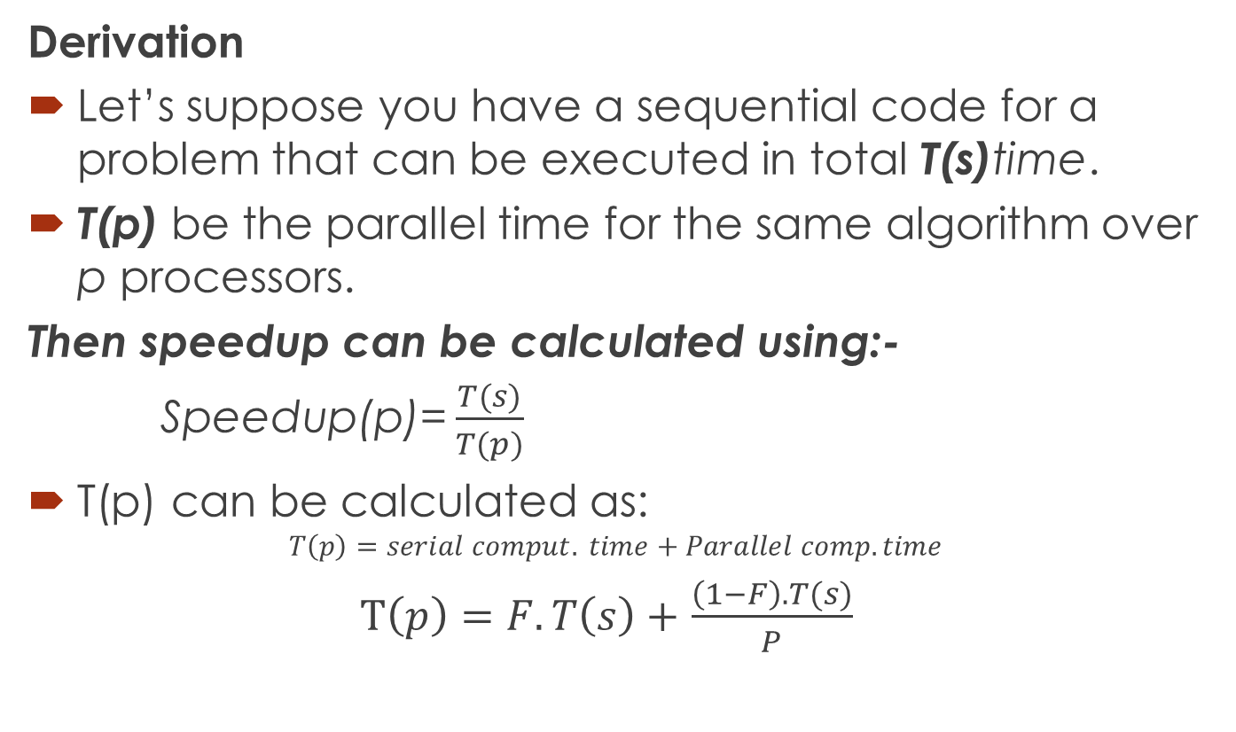
Amdahl’s Law
Derivation
Let’s suppose you have a sequential code for a problem that can be executed in total T(s)time.
T(p) be the parallel time for the same algorithm over p processors.
Then speedup can be calculated using:-
$\text{Speedup}\text{(}\text{p}\text{)=}\frac{T(s)}{T(p)}$
T(p) can be calculated as:
$$T\left(p\right)=serial comput. time+Parallel comp. time$$
$T\left(p\right)=F.T\left(s\right)+$ $\frac{\left(1−F\right).T(s)}{P}$
Notes:
What and when

Slide 5
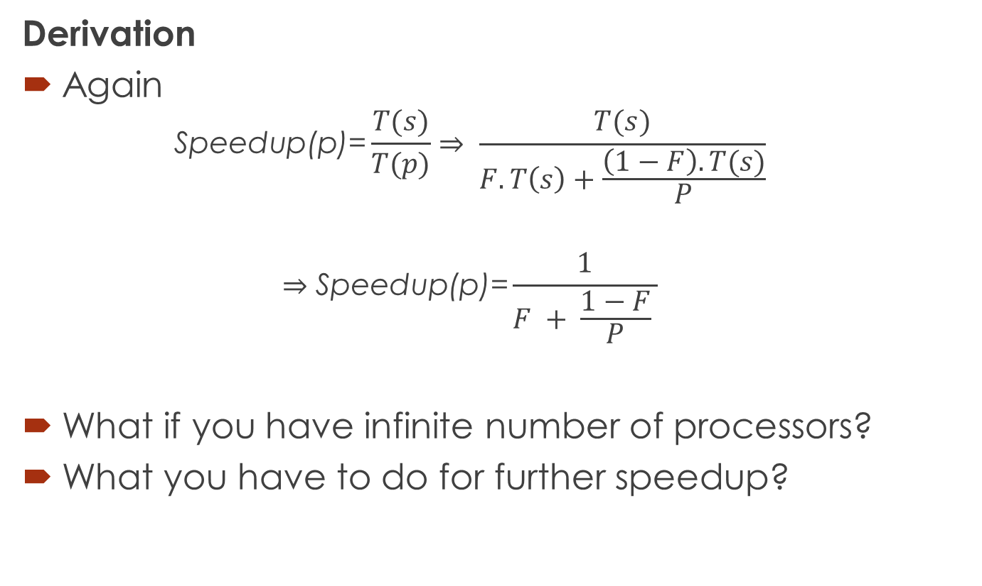
Amdahl’s Law
Derivation
Again
  $$\text{Speedup}\text{(}\text{p}\text{)=}\frac{T(s)}{T(p)}⇒ \frac{T(s)}{F.T\left(s\right)+\frac{\left(1−F\right).T(s)}{P}}$$
  $$⇒\text{Speedup}\text{(}\text{p}\text{)=}\frac{1}{F + \frac{1−F}{P} }$$
What if you have infinite number of processors?
What you have to do for further speedup?

Slide 6
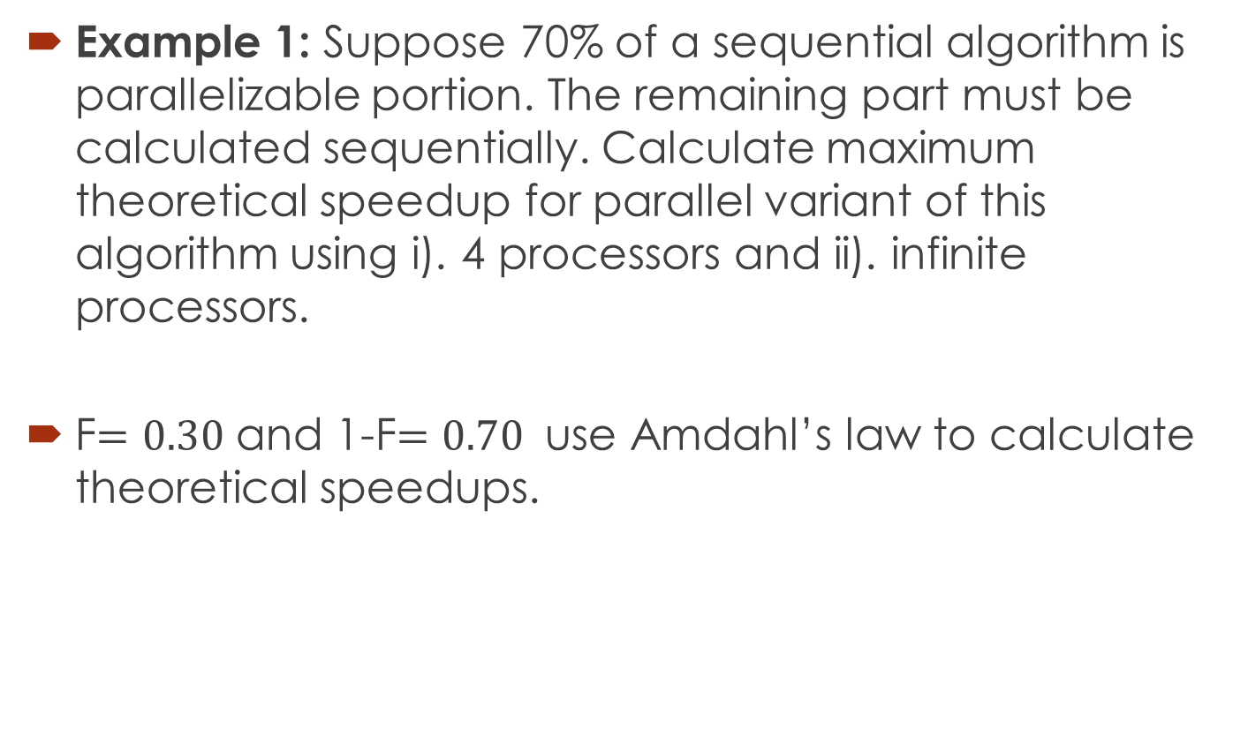
Amdahl’s Law
Example 1: Suppose 70% of a sequential algorithm is parallelizable portion. The remaining part must be calculated sequentially. Calculate maximum theoretical speedup for parallel variant of this algorithm using i). 4 processors and ii). infinite processors.
F$=0.30$ and 1-F$=0.70$ use Amdahl’s law to calculate theoretical speedups.
Notes:
Max speedup=3.33, for four Processors=2.11

Slide 7
Amdahl’s Law
Example 2: Suppose 25% of a sequential algorithm is parallelizable portion. The remaining part must be calculated sequentially. Calculate maximum theoretical speedup for parallel variant of this algorithm using 5 processors and infinite processors.
???
Little challenge: Determine, according to Amdahl's law, how many processors are needed to achieve maximum theoretical speedup while sequential portion remains the same?
The answer may be surprising?
That’s why we say actual achievable speedup is always less-than or equal to theoretical speedups.
Notes:
Max = 1.33, for 5 Processors=1.25, 133

Slide 8
Karp-Flatt Metric

Slide 9
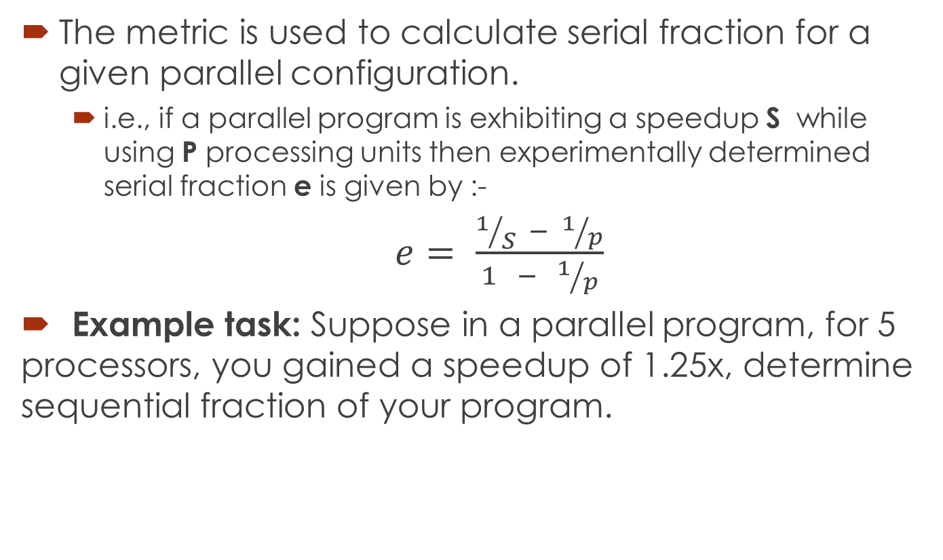
Karp-Flatt Metric
The metric is used to calculate serial fraction for a given parallel configuration.
  i.e., if a parallel program is exhibiting a speedup S while using P processing units then experimentally determined serial fraction e is given by :-
  $e= \frac{1/S − 1/p}{1 − 1/p}$
  Example task: Suppose in a parallel program, for 5 processors, you gained a speedup of 1.25x, determine sequential fraction of your program.
Notes:
proposed by Alan H. Karp and Horace P. Flatt in 1990.
To determine to what extent an algorithm is parallelized.
Here e is 0.75
One more use case: -
if metric value remains consistent w.r.t. increasing number of processors and speedups → You need to reduce sequential fraction.
if metric value increases as increasing number of processors and speedups → You need to parallelize overheads.

Slide 10
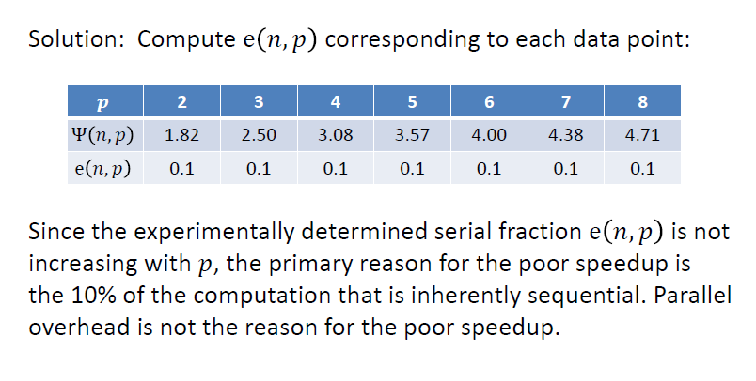
Notes:
Parallel Overhead:
The amount of time required to coordinate parallel tasks, as opposed to doing useful work. Parallel overhead can include factors such as: Task start-up time. Synchronizations.

Slide 11
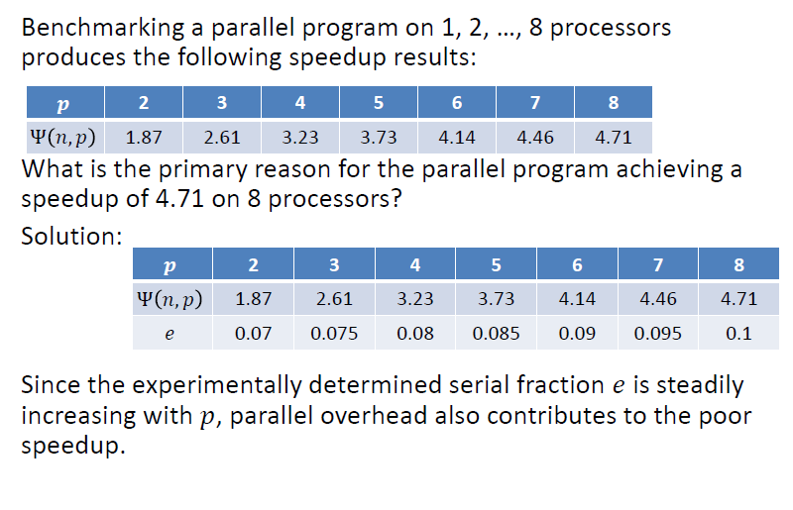

Slide 12
Types of Parallelism

Slide 13
Types of Parallelism
Data-parallelism
When there are independent tasks applying the same operation to different elements of a data set
Example code
  for i= to 99 do
  a[ i ] = b[ i ] + c [ i ]
  Endfor
Here same operation addition is being performed on first 100 of ‘b’ and ‘c’
All 100 iterations of the loop could be executed simultaneously.

Slide 14
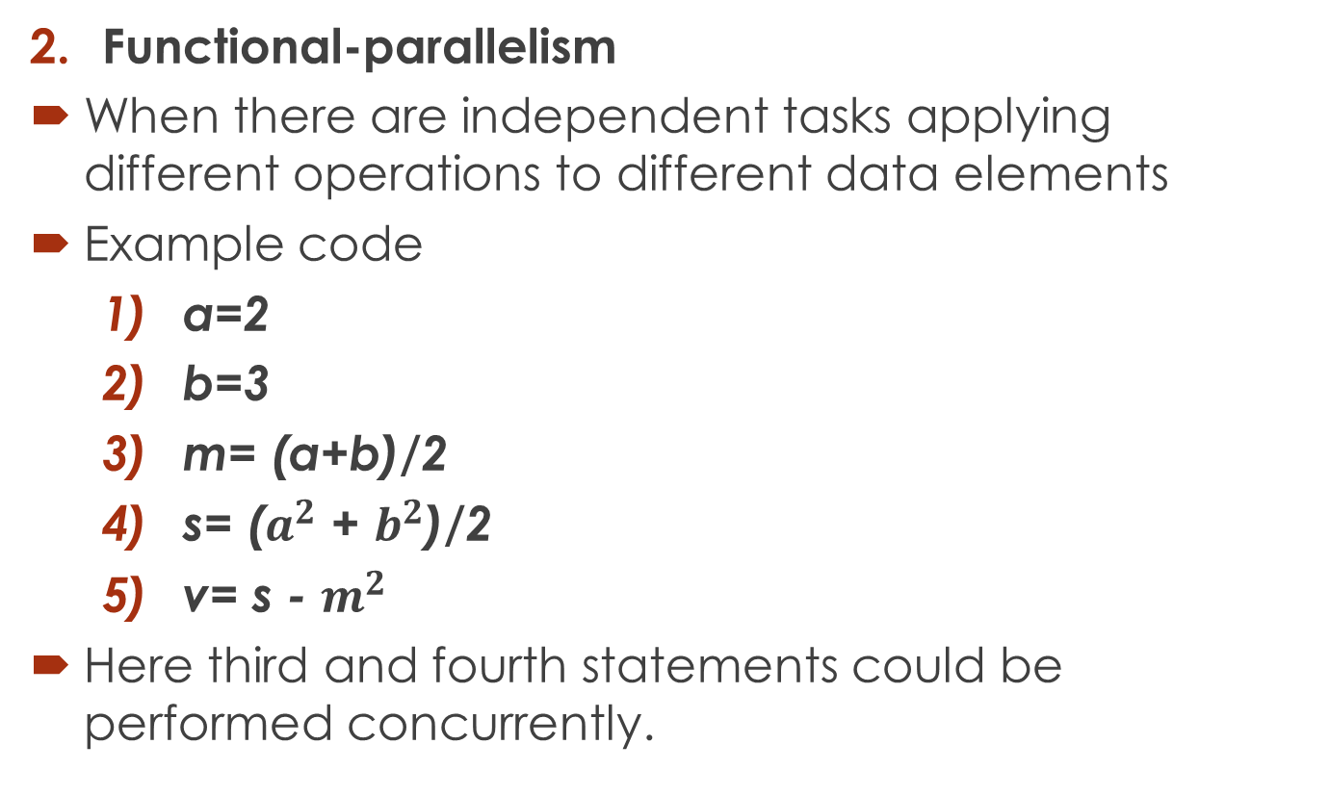
Types of Parallelism
Functional-parallelism
When there are independent tasks applying different operations to different data elements
Example code
  a=2
  b=3
  m= (a+b)/2
  s= ($a^{2}$ + $b^{2}$)/2
  v= s - $m^{2}$
Here third and fourth statements could be performed concurrently.

Slide 15
Types of Parallelism
Pipelining
Usually used for the problems where single instance of the problem can not be parallelized
The output of one stage is input of the other stage
Dividing whole computation of each instance into multiple stages provided that there are multiple instances of the problem
An effective method of attaining parallelism on the uniprocessor architectures
Depends on pipelining abilities of the processor
Notes:
Pentium-II supports 12 stage pipelining and Pentium 4 supports 20 stage pipelining at 2.0 GHz

Slide 16
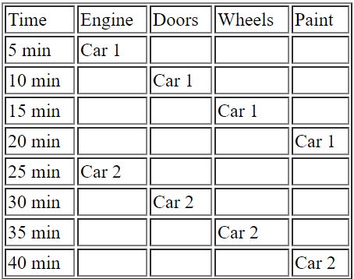
Types of Parallelism
Pipelining
Example: Assembly line analogy
Sequential Execution

Slide 17
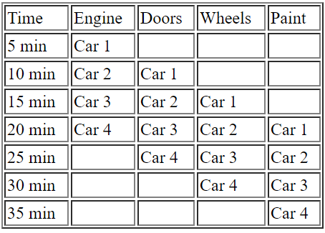
Types of Parallelism
Pipelining
Example: Assembly line analogy
Pipelining

Slide 18
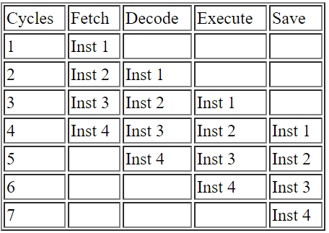
Types of Parallelism
Pipelining
Example: Overlap instructions in a single instruction cycle to achieve parallelism
4-stage Pipelining
Notes:
Pentium-II supports 12 stage pipelining and Pentium 4 supports 20 stage pipelining at 2.0 GHz
Branch prediction issues occurs as you increase pipelining.
Super-scaler executions: the ability of the processor to issue multiple instructions in same cycle e.g., 2 decodes etc

Slide 19
Multi-processor vs
Multi-Computer

Slide 20
Multi-Processor
Multiple-CPUs with a shared memory
The same address on two different CPUs refers to the same memory location.
Generally two categories:-
  Centralized Multi-processors
  Distributed Multi-processor

Slide 21
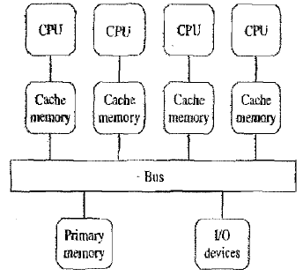
Multi-Processor
Centralized Multi-processor
Additional CPUs are attached to the system bus, and all the processors share the same primary memory
All the memory is at one place and has the same access time from every processor
Also known to as UMA(Uniform Memory Access) multi-processor or SMP (symmetrical Multi-processor )
Notes:
Assigned reading: Cache coherence problems, snooping
Restriction on maximum number of CPUs. Solution?

Slide 22
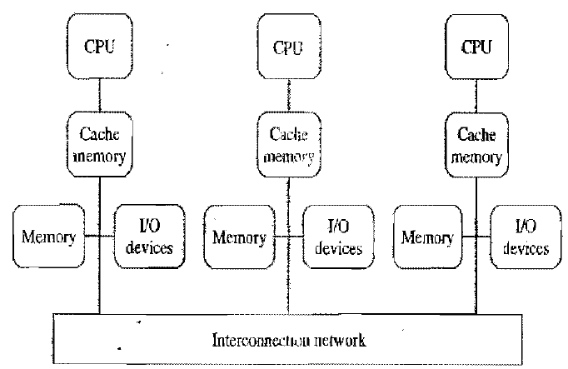
Multi-Processor
Distributed Multi-processor
Distributed collection of memories forms one logical address space
Again, the same address on different processors refers to the same memory location.
Also known as non-uniform memory access (NUMA) architecture
Because, memory access time varies significantly, depending on the physical location of the referenced address
Notes:
e.g., if referenced address is in processor’s local memory then access time will very low

Slide 23
Multi-Computer
Distributed-memory, multi-CPU computer
Unlike NUMA architecture, a multicomputer has disjoint local address spaces
Each processor has direct access to their local memory only.
The same address on different processors refers to two different physical memory locations.
Processors interact with each other through passing messages
Notes:
No cache coherence.
Multi-computers are usually less expensive
Provide more scalability

Slide 24
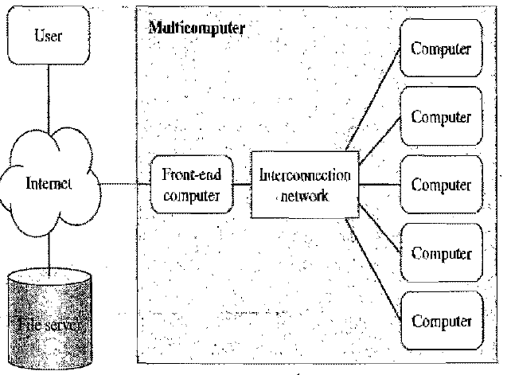
Multi-Computer
Asymmetric Multi-Computers
A front-end computer that interacts with users and I/O devices
The back-end processors are dedicatedly used for “number crunching”
Front-end computer executes a full, multiprogrammed OS and provides all functions needed for program development
The backends are reserved for executing parallel programs
Notes:
Front:AXIS—Backend:VERTEX

Slide 25
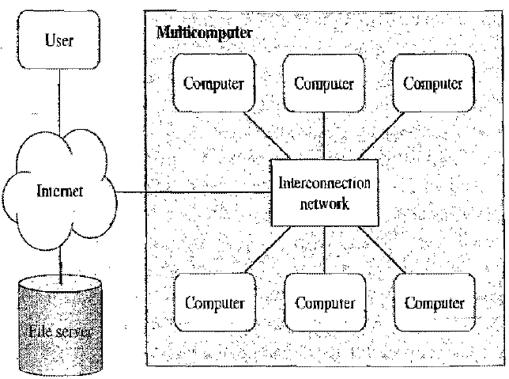
Multi-Computer
Symmetric Multi-Computers
Every computer executes same OS
Users may log into any of the computers
This enables multiple users to concurrently login, edit and compile their programs.
All the nodes can participate in execution of a parallel program

Slide 26
Network of Workstations vs
Cluster

Slide 27
Cluster | Network of workstations
Usually a co-located collection of low-cost computers and switches, dedicated to running parallel jobs. All computer run the same version of operating system. | A dispersed collection of computers. Individual workstations may have different Operating systems and executable programs
Some of the computers may not have interfaces for the users to login | User have the power to login and power off their workstations
Commodity cluster uses high speed networks for communication such as fast Ethernet@100Mbps, gigabit Ethernet@1000 Mbps and Myrinet@1920 Mbps. | Ethernet speed for this network is usually slower. Typical in range of 10 Mbps

Slide 28
Reading Assignment
  Cache Coherence and Snooping
  Branch prediction and issues while pipelining the problem

Slide 29
Assigned reading pointers:
Cache Coherence:
  When we are in a distributed environment, each CPU’s cache needs to be consistent (continuously needs to be updated for current values), which is known as cache coherence.
Snooping:
  Snoopy protocols achieve data consistency between the cache memory and the shared memory through a bus-based memory system. Write-invalidate and write-update policies are used for maintaining cache consistency.
Branch Prediction:
  Branch prediction is a technique used in CPU design that attempts to guess the outcome of a conditional operation and prepare for the most likely result.
Notes:
Issues in pipelining of branch prediction:
If the prediction is true then the pipeline will not be flushed and no clock cycles will be lost. If the prediction is false then the pipeline is flushed and starts over with the current instruction.

Slide 30

Questions

Slide 31
